Slide 1

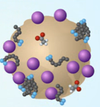

Slide 2
Brown balls: Microaggregate

